Slide 1
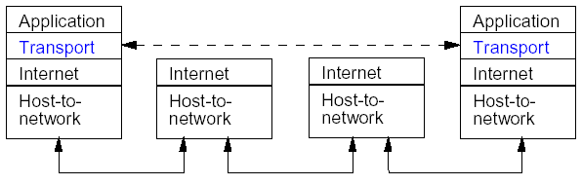
Transport Layer
Transport layer is an end-to-end layer – this means that nodes within the subnet do not participate in transport layer protocols – only the end hosts.
As with other layers, transport layer protocols send data as a sequence of packets (segments).
The transport layer provides communication between two processes running on different hosts.

Slide 2
Transport Layer
Services
Elements of transport protocol
Simple transport protocol
UDP
Remote Procedure Call
TCP

Slide 3
The Transport Service
Services Provided to the Upper Layers
Transport Service Primitives
Berkeley Sockets

Slide 4
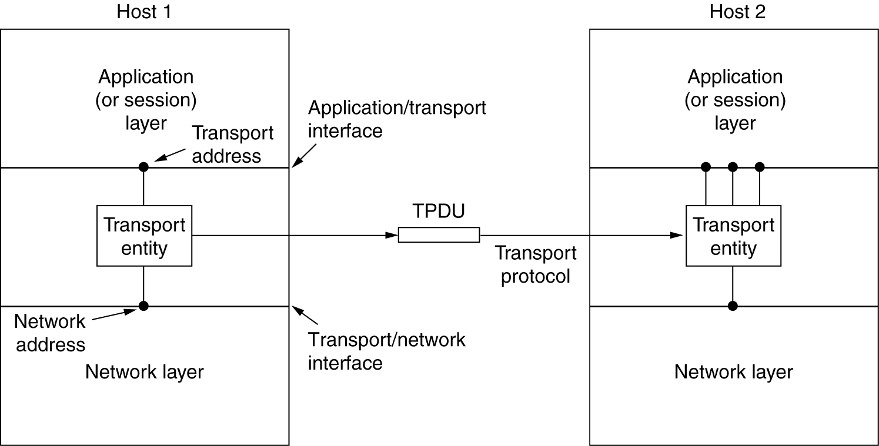
Services Provided to the Upper Layers
The network, transport, and application layers.

Slide 5
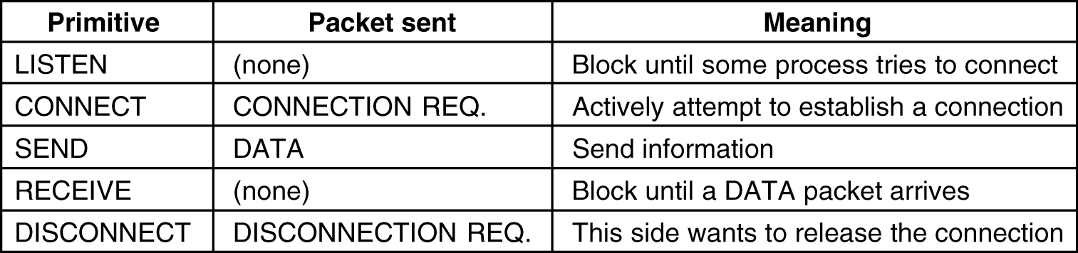
Transport Service Primitives
The primitives for a simple transport service.

Slide 6
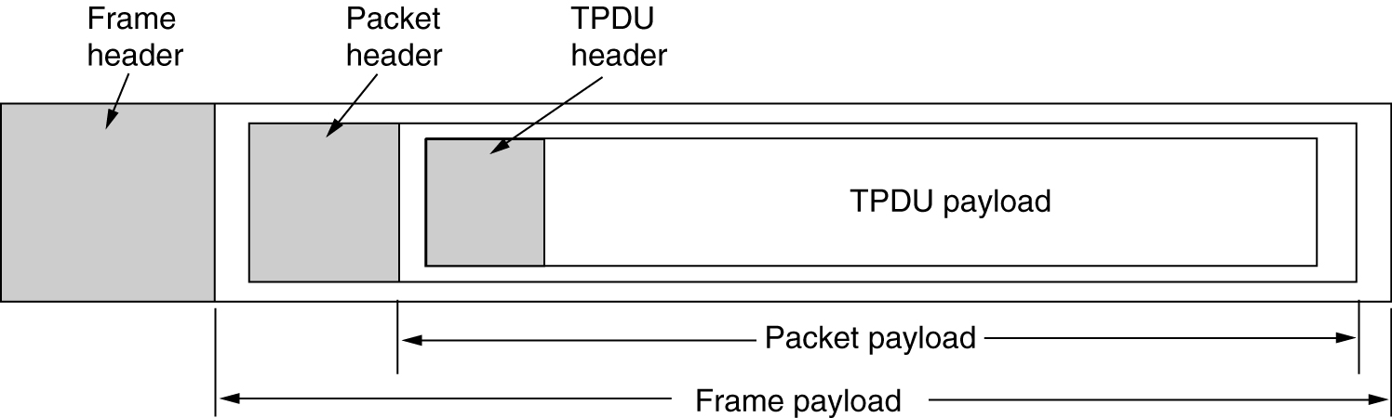
Transport Service Primitives (2)
The nesting of TPDUs, packets, and frames.

Slide 7
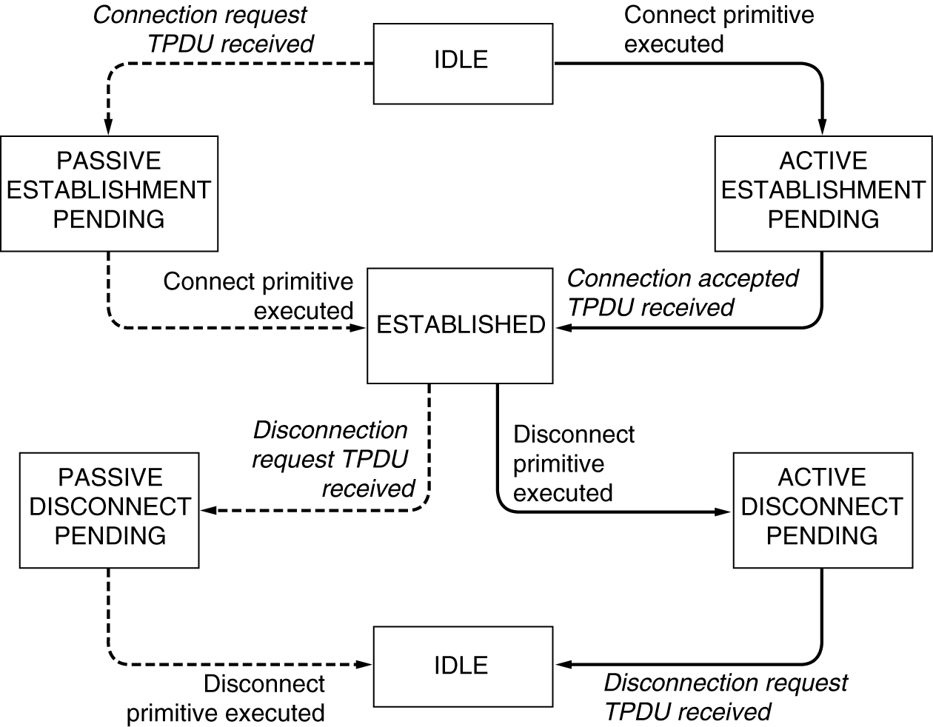
Transport Service Primitives (3)
A state diagram for a simple connection management scheme. Transitions labeled in italics are caused by packet arrivals. The solid lines show the client's state sequence. The dashed lines show the server's state sequence.

Slide 8
Berkeley service primitives
Used in Berkeley UNIX for TCP
Addressing primitives:
Server primitives:
Client primitives:
socket
bind
listen
accept
send + receive
close
connect
send + receive
close

Slide 9
Berkeley service primitives
socket | create new communication end point
bind | attach a local address to a socket
listen | announce willingness to accept connections; give queue size
accept | block caller until a connection request arrives
connect | actively attempt to establish a connection
send | send some data over the connection
receive | receive some data from the connection
close | release the connection

Slide 10
Elements of Transport Protocols
Addressing
Connection Establishment
Connection Release
Flow Control and Buffering
Multiplexing
Crash Recovery

Slide 11
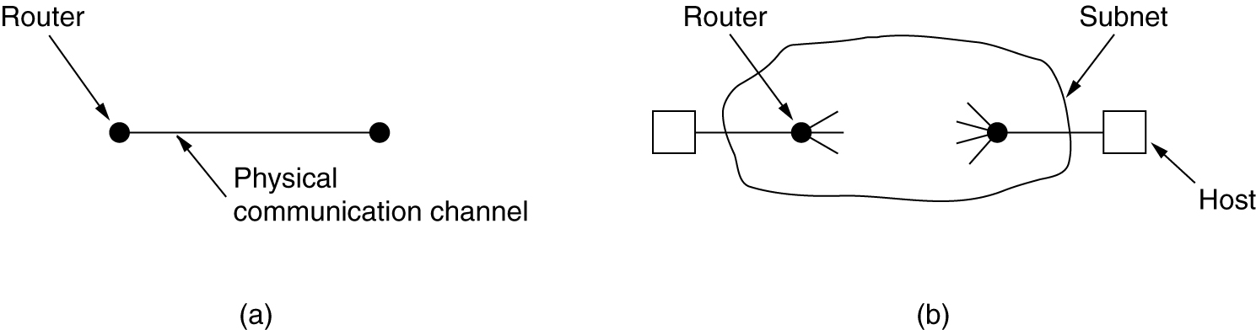
Transport Protocol
(a) Environment of the data link layer.
(b) Environment of the transport layer.

Slide 12
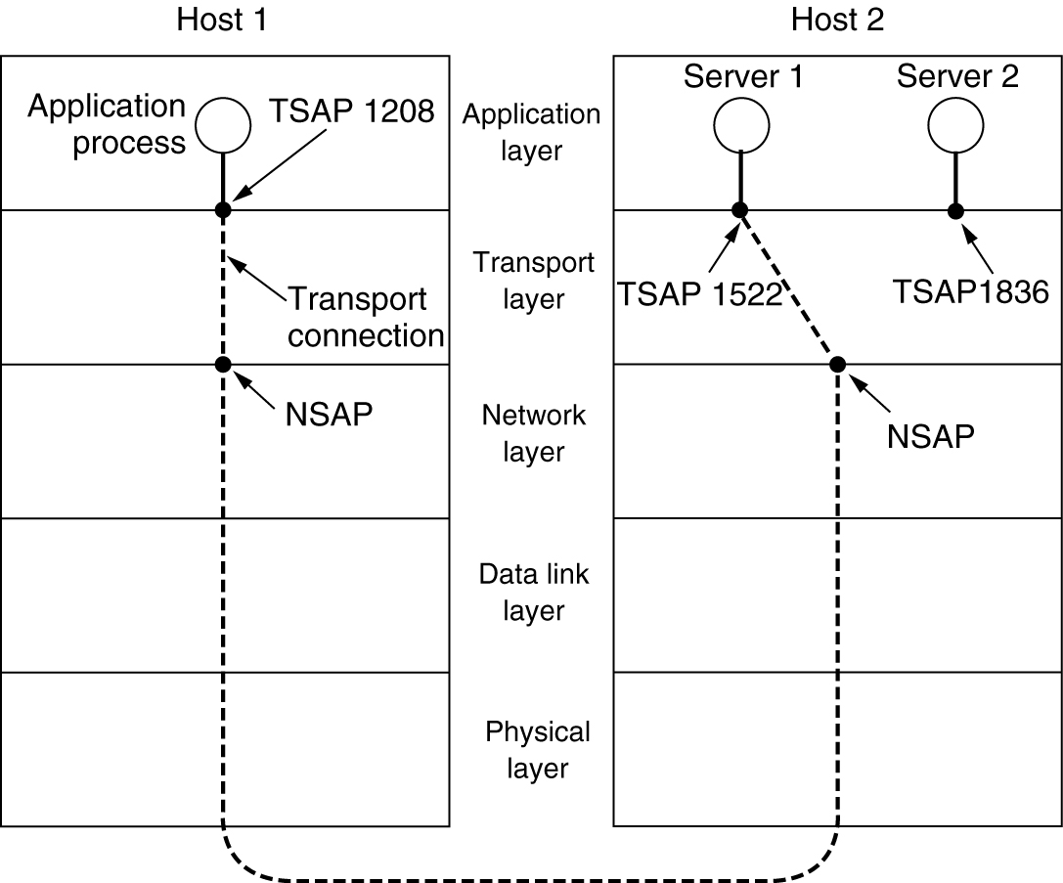
Addressing
When an application process wishes to set up a connection to a remote application process, it must specify which one to connect to. (Connectionless transport has the same problem: to whom should each message be sent?) The method normally used is to define transport addresses to which processes can listen for connection requests.
TSAPs, NSAPs and transport connections.

Slide 13
Connection Establishment
Source send a CONNECTION REQUEST segment to the destination and wait for a CONNECTION ACCEPTED reply.
The problem occurs when the network can delay, corrupt, and duplicate packets
Problem: same packets are received in same order a second time!
Recognized?

Slide 14
Connection Establishment
Satisfactory solutions
Ensure limited packet lifetime (incl. Acks)
Mechanisms
prevent packets from looping
Hop counter in each packet
timestamp in each packet
Maximum packet lifetime T

Slide 15
Connection Establishment
Tomlinson’s method
Problems to solve
Selection of the initial sequence number for a new connection
Wrap around of sequence numbers for an active connection
Handle host crashes
Never reuse a sequence number x within the lifetime T for the packet with x

Slide 16
Connection Establishment
Tomlinson’s method
requires: clock in each host
Number of bits > number of bits in sequence number
Clock keeps running, even when a hosts crashes
Initial sequence number = lower order bits of clock
Ensure initial sequence numbers are always OK ➔ forbidden region

Slide 17
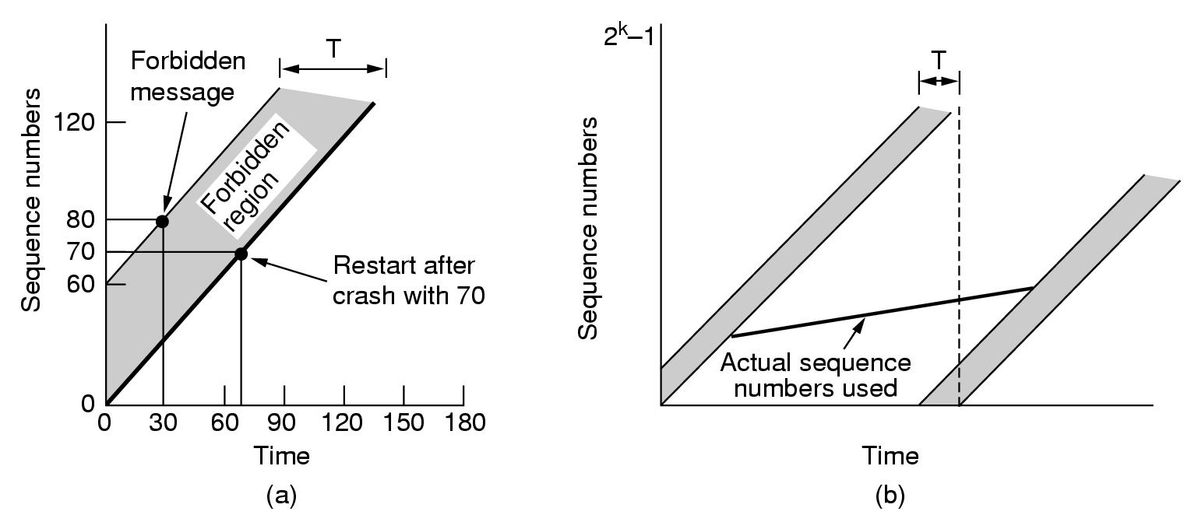
Connection Establishment
Tomlinson - forbidden region

Slide 18
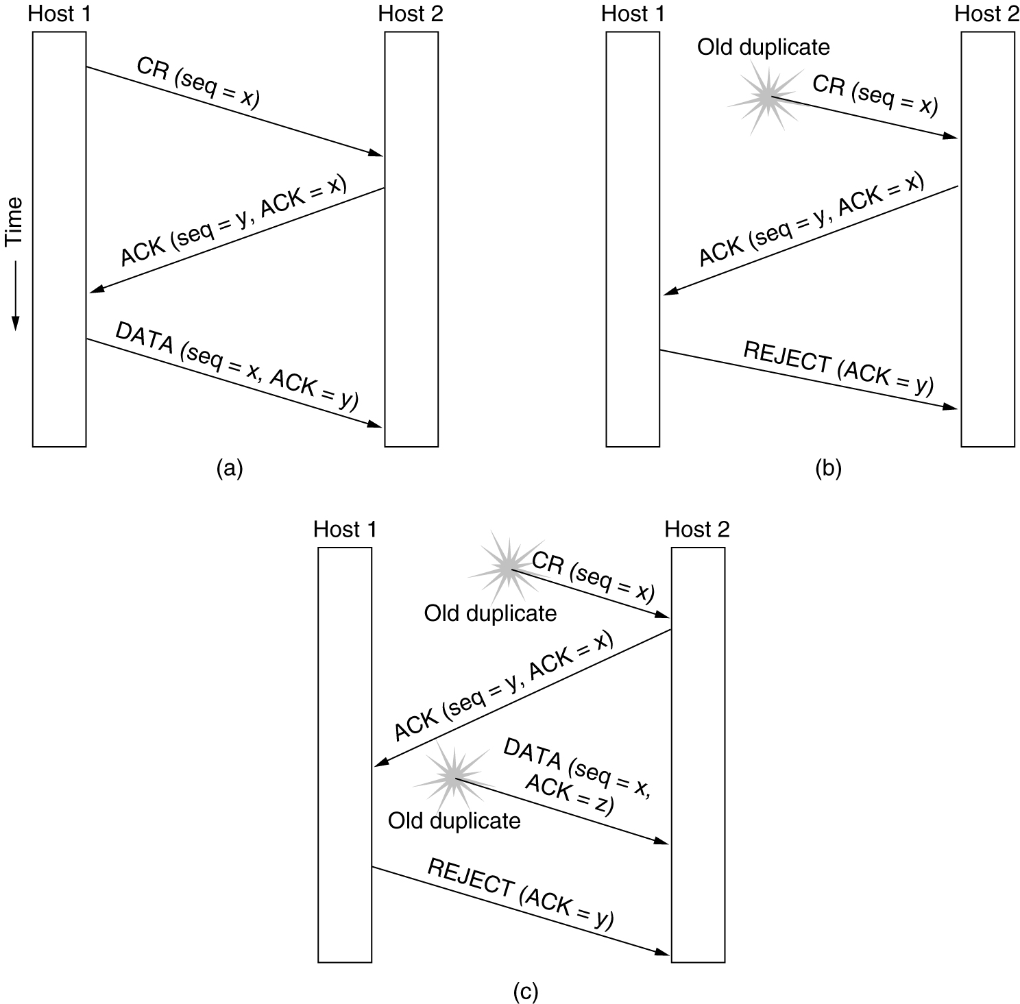
Connection Establishment
Tomlinson – three-way-handshake
Three protocol scenarios for establishing a connection using a three-way handshake. CR denotes CONNECTION REQUEST. (a) Normal operation, (b) Old CONNECTION REQUEST appearing out of nowhere. (c) Duplicate CONNECTION REQUEST and duplicate ACK.

Slide 19
Releasing a connection
2 styles:
Asymmetric
Connection broken when one party hangs up
Abrupt! ➔ may result in data loss
Symmetric
Both parties should agree to release connection
How to reach agreement? Two-army problem
Solution: three-way-handshake

Slide 20
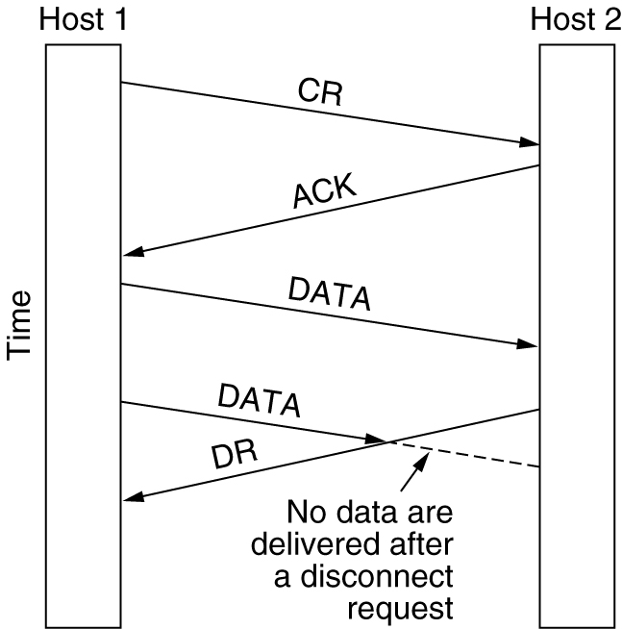
Connection Release
Asymmetric: data loss
Abrupt disconnection with loss of data.

Slide 21
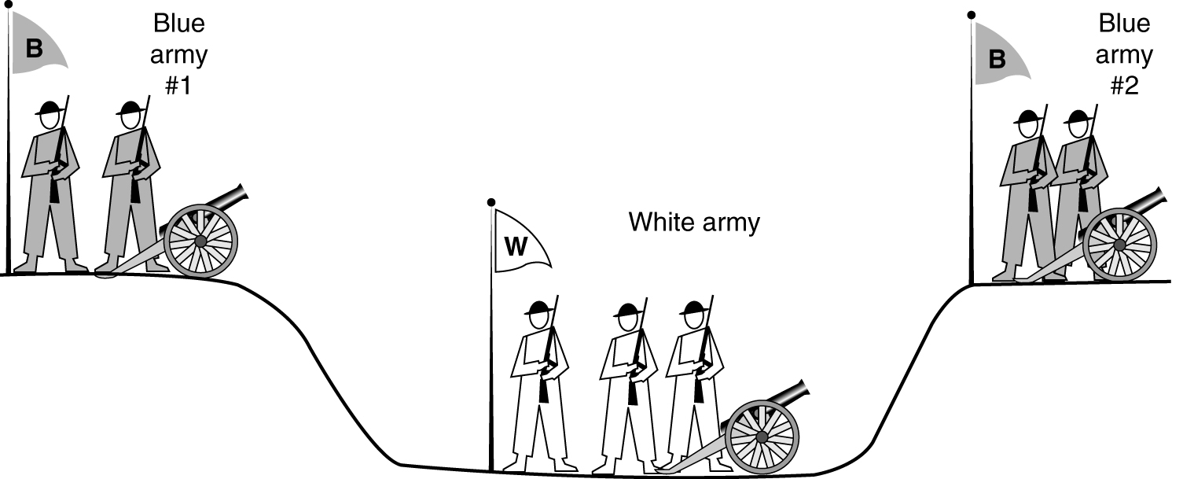
Connection Release (2)
Symmetric: two-army-problem
The two-army problem.

Slide 22
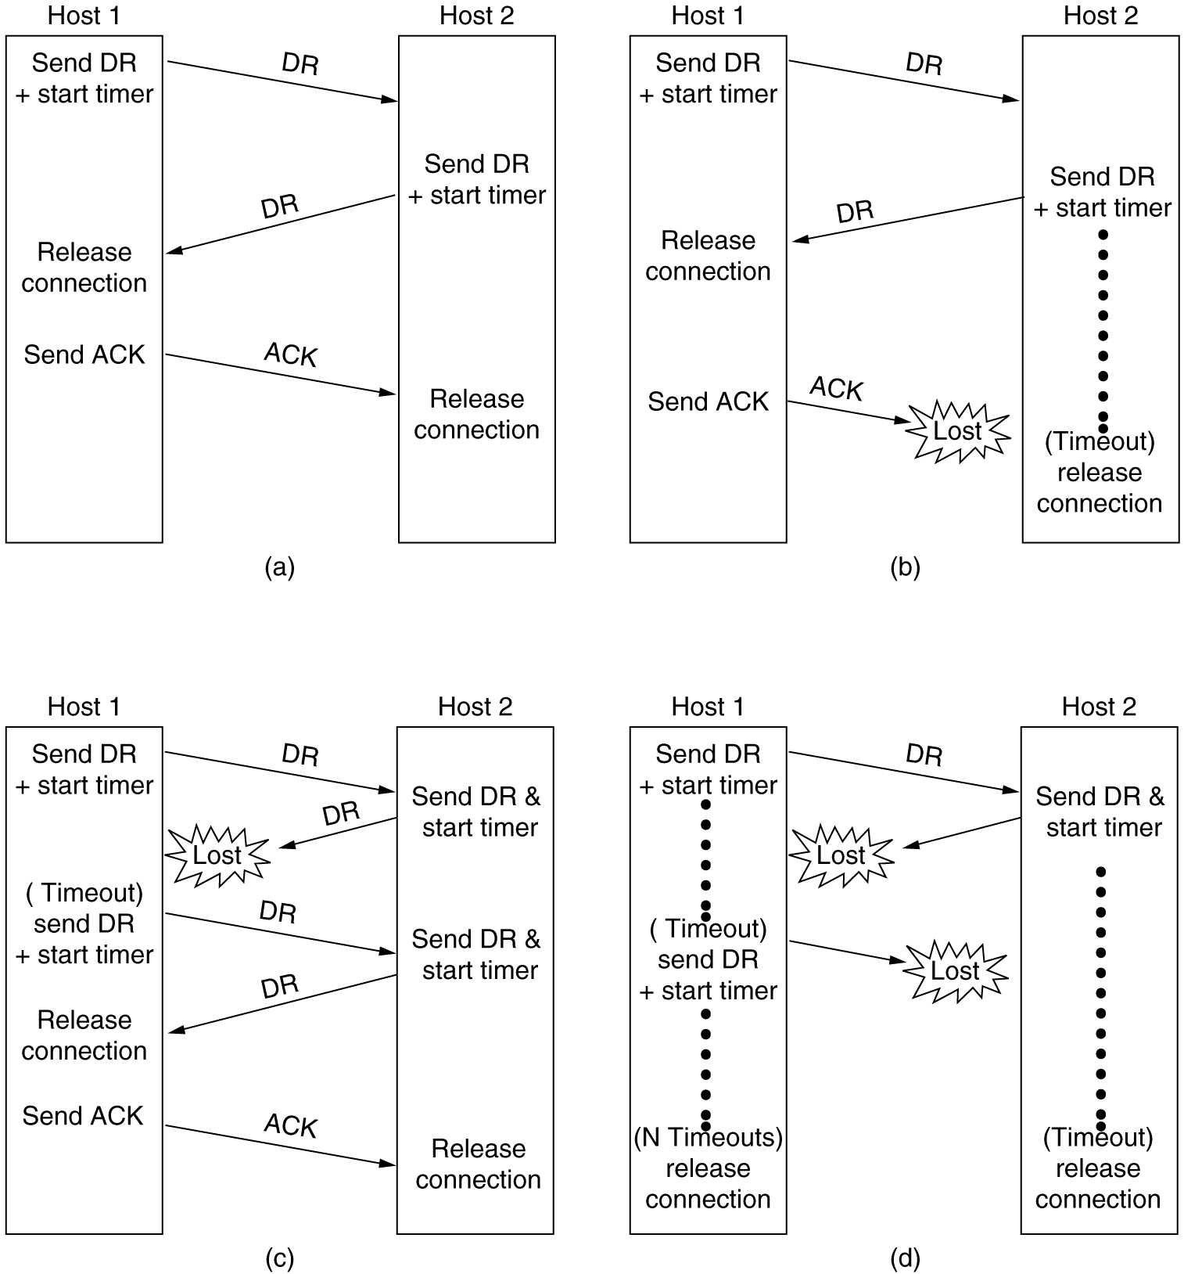
Connection Release (3)
6-14, a, b
Four protocol scenarios for releasing a connection. (a) Normal case of a three-way handshake. (b) final ACK lost.

Slide 23
Connection Release (4)
6-14, c,d
(c) Response lost. (d) Response lost and subsequent DRs lost.

Slide 24
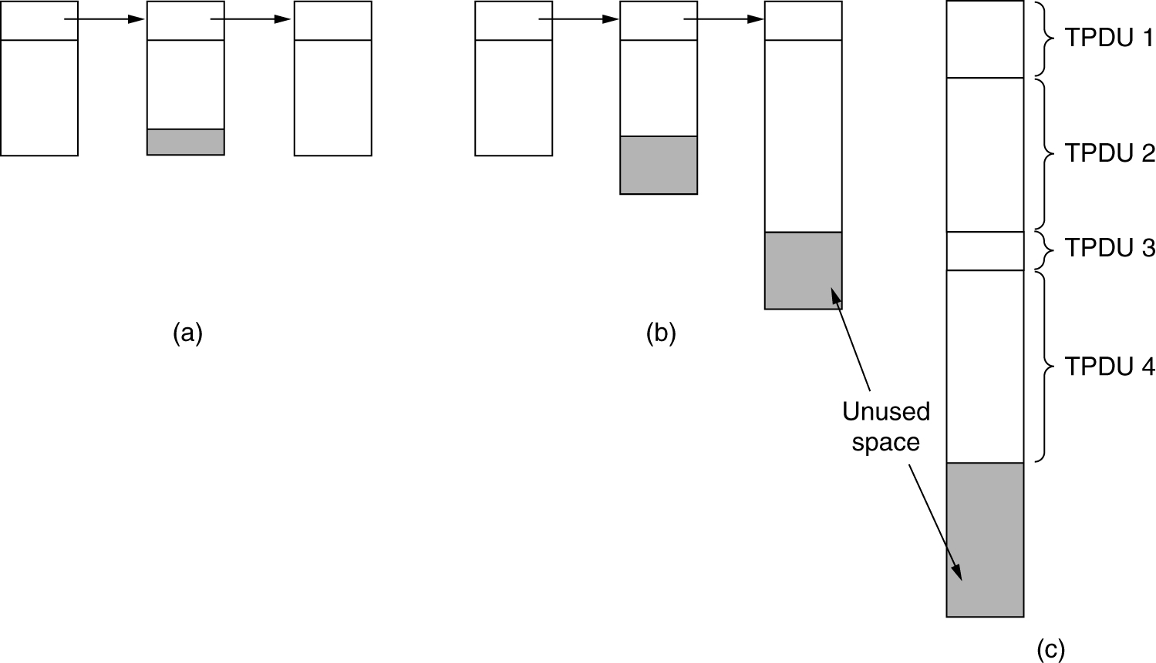
Flow Control and Buffering
(a) Chained fixed-size buffers. (b) Chained variable-sized buffers. (c) One large circular buffer per connection.

Slide 25
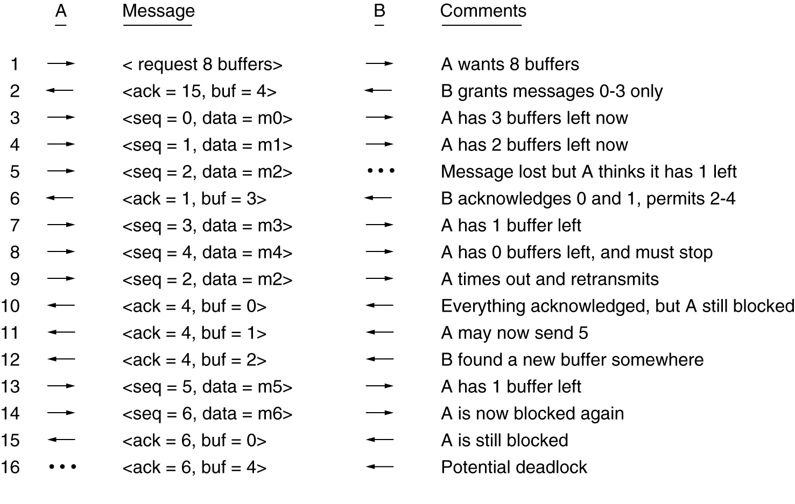
Flow Control and Buffering (2)
Dynamic buffer allocation. The arrows show the direction of transmission. An ellipsis (…) indicates a lost TPDU.

Slide 26
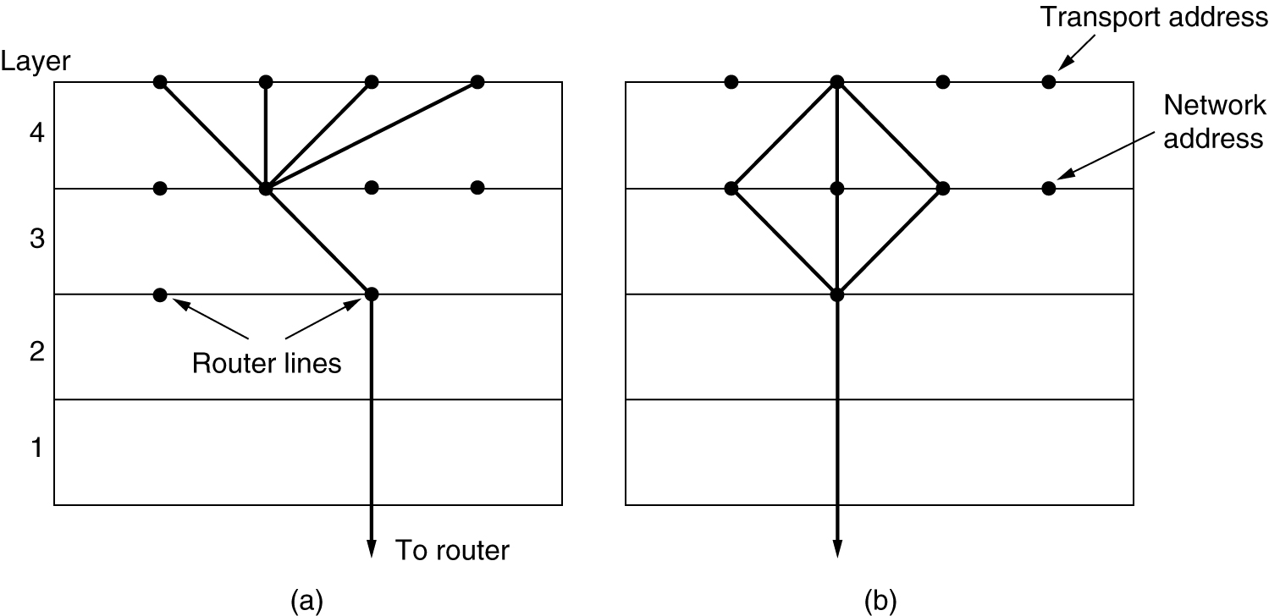
Multiplexing
(a) Upward multiplexing. (b) Downward multiplexing.

Slide 27
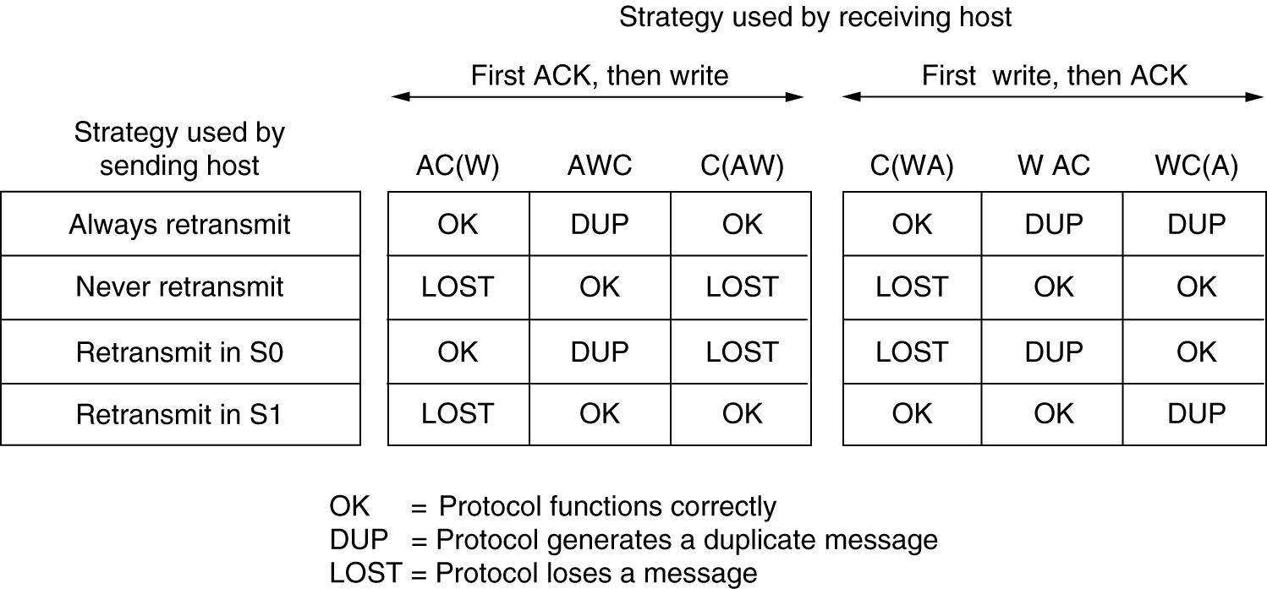
Crash Recovery
Different combinations of client and server strategy.

Slide 28
The Internet Transport Protocols: UDP
Introduction to UDP
Remote Procedure Call
The Real-Time Transport Protocol

Slide 29
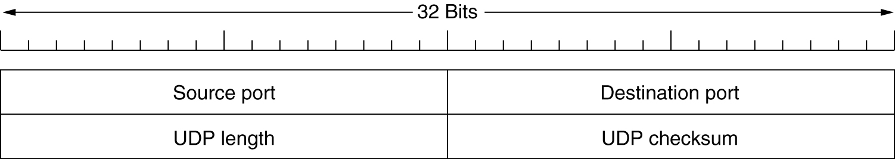
Introduction to UDP
The UDP header.

Slide 30
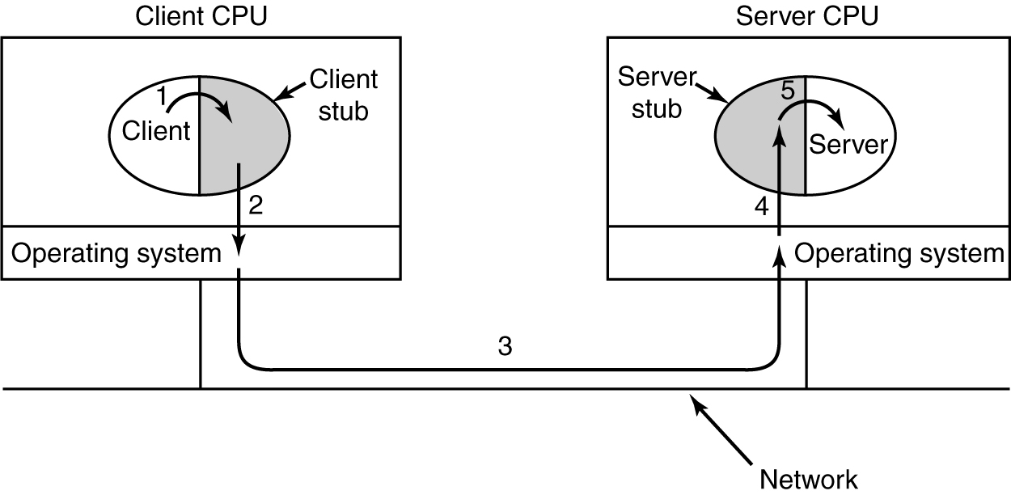
Remote Procedure Call
Steps in making a remote procedure call. The stubs are shaded.

Slide 31
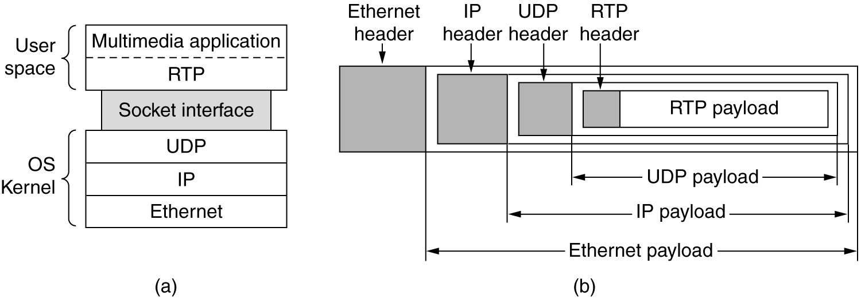
The Real-Time Transport Protocol
(a) The position of RTP in the protocol stack. (b) Packet nesting.

Slide 32
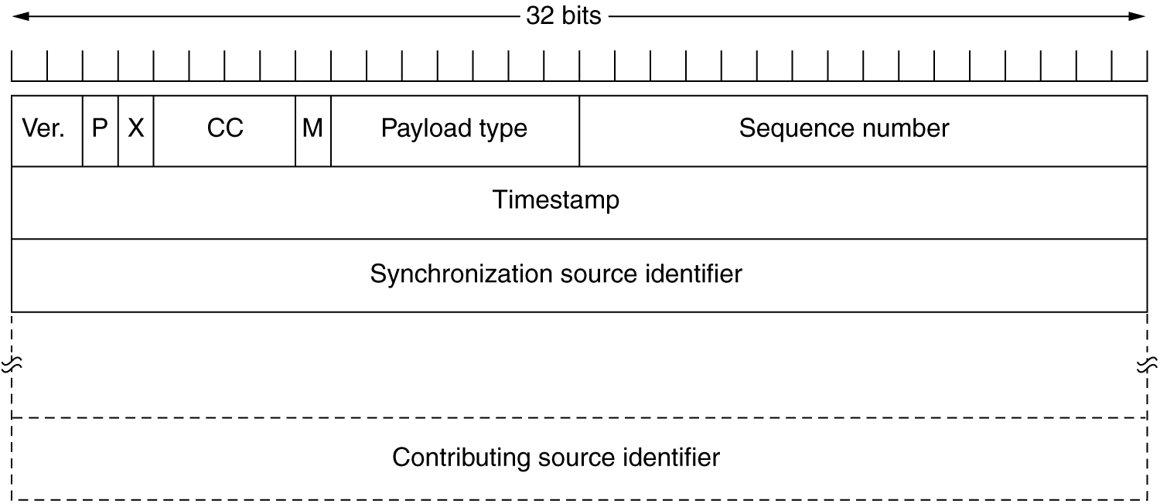
The Real-Time Transport Protocol (2)
The RTP header.

Slide 33
The Internet Transport Protocols: TCP
Introduction to TCP
The TCP Service Model
The TCP Protocol
The TCP Segment Header
TCP Connection Establishment
TCP Connection Release
TCP Connection Management Modeling
TCP Transmission Policy
TCP Congestion Control
TCP Timer Management
Wireless TCP and UDP
Transactional TCP

Slide 34
The TCP Service Model
Port
Protocol
Use
21
FTP
File transfer
23
Telnet
Remote login
25
SMTP
E-mail
69
TFTP
Trivial File Transfer Protocol
79
Finger
Lookup info about a user
80
HTTP
World Wide Web
110
POP-3
Remote e-mail access
119
NNTP
USENET news
Some assigned ports.

Slide 35
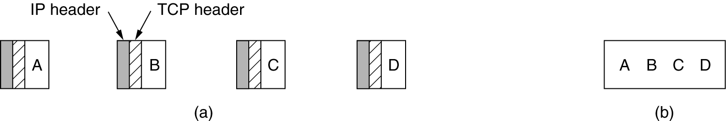
The TCP Service Model (2)
(a) Four 512-byte segments sent as separate IP datagrams.
(b) The 2048 bytes of data delivered to the application in a single READ CALL.

Slide 36
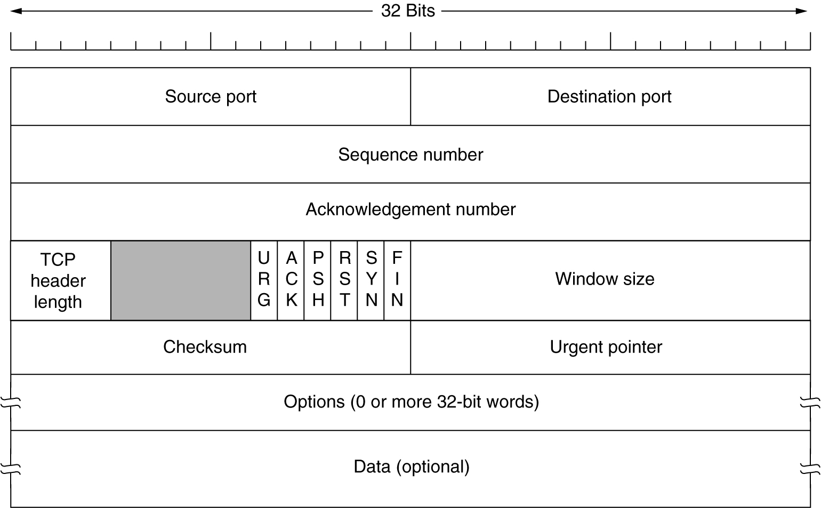
The TCP Segment Header
TCP Header.

Slide 37
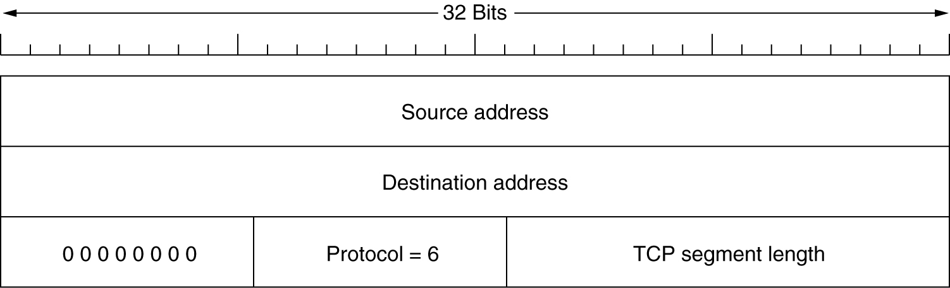
The TCP Segment Header (2)
The pseudoheader included in the TCP checksum.

Slide 38
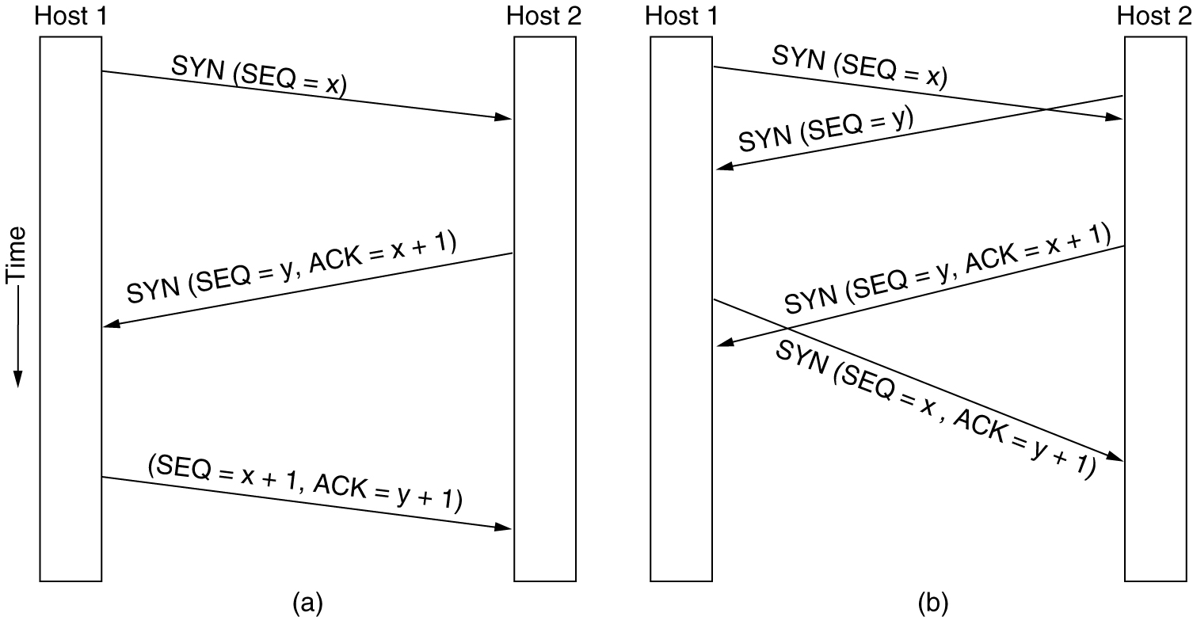
TCP Connection Establishment
6-31
(a) TCP connection establishment in the normal case.
(b) Call collision.

Slide 39
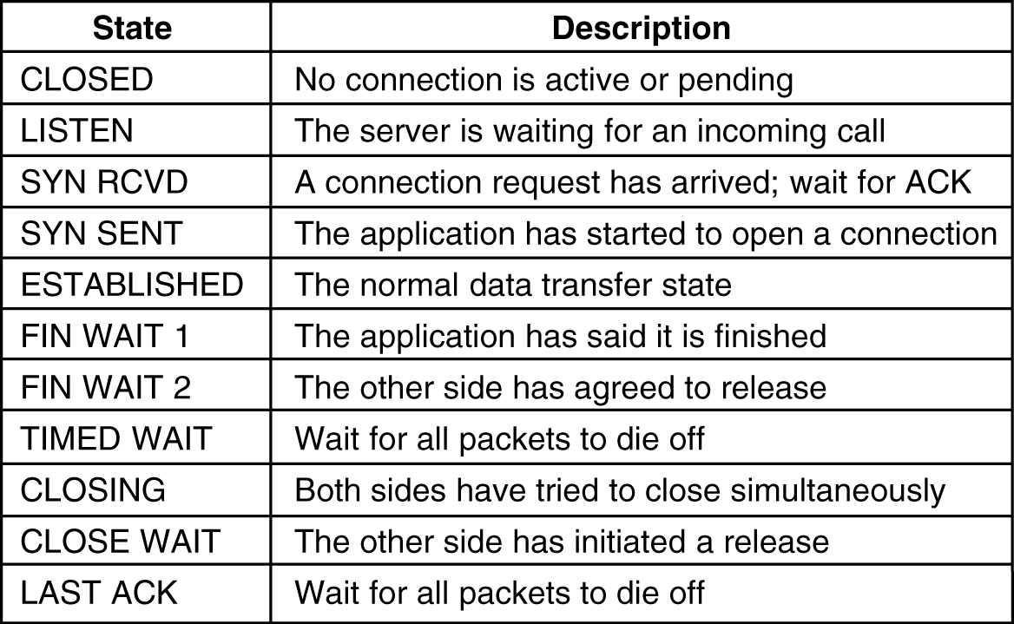
TCP Connection Management Modeling
The states used in the TCP connection management finite state machine.

Slide 40
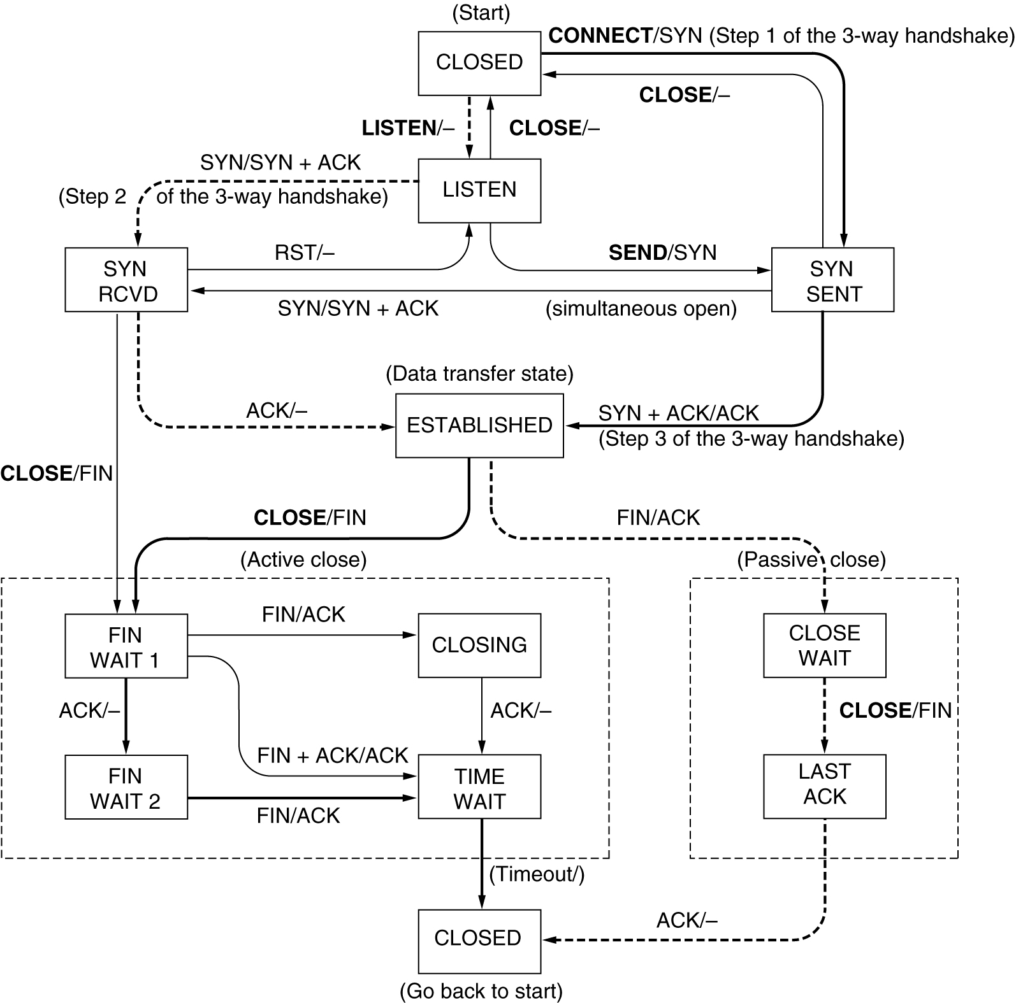
TCP Connection Management Modeling (2)
TCP connection management finite state machine. The heavy solid line is the normal path for a client. The heavy dashed line is the normal path for a server. The light lines are unusual events. Each transition is labeled by the event causing it and the action resulting from it, separated by a slash.

Slide 41
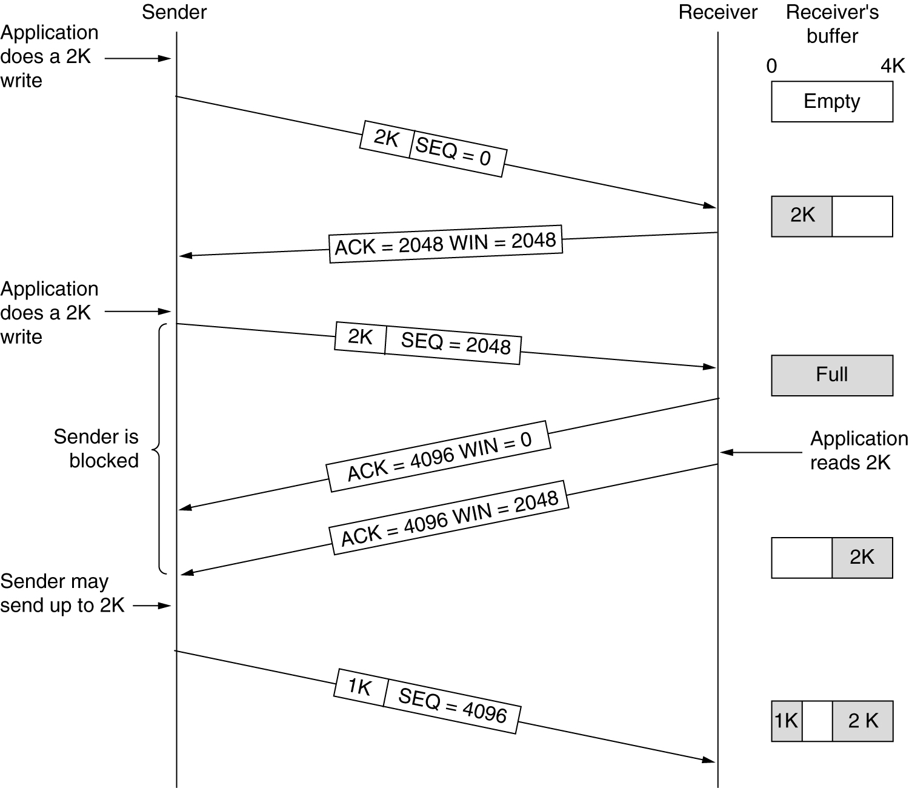
TCP Transmission Policy
Window management in TCP.

Slide 42
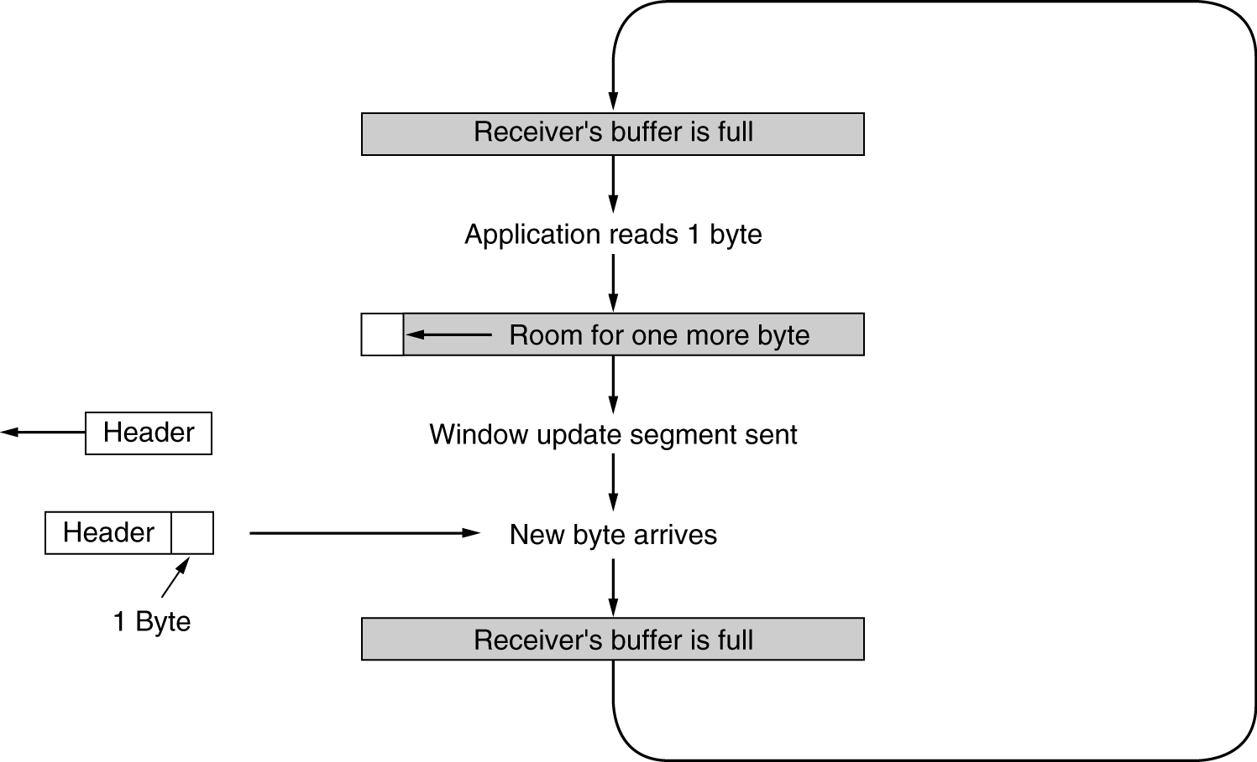
TCP Transmission Policy (2)
Silly window syndrome.

Slide 43
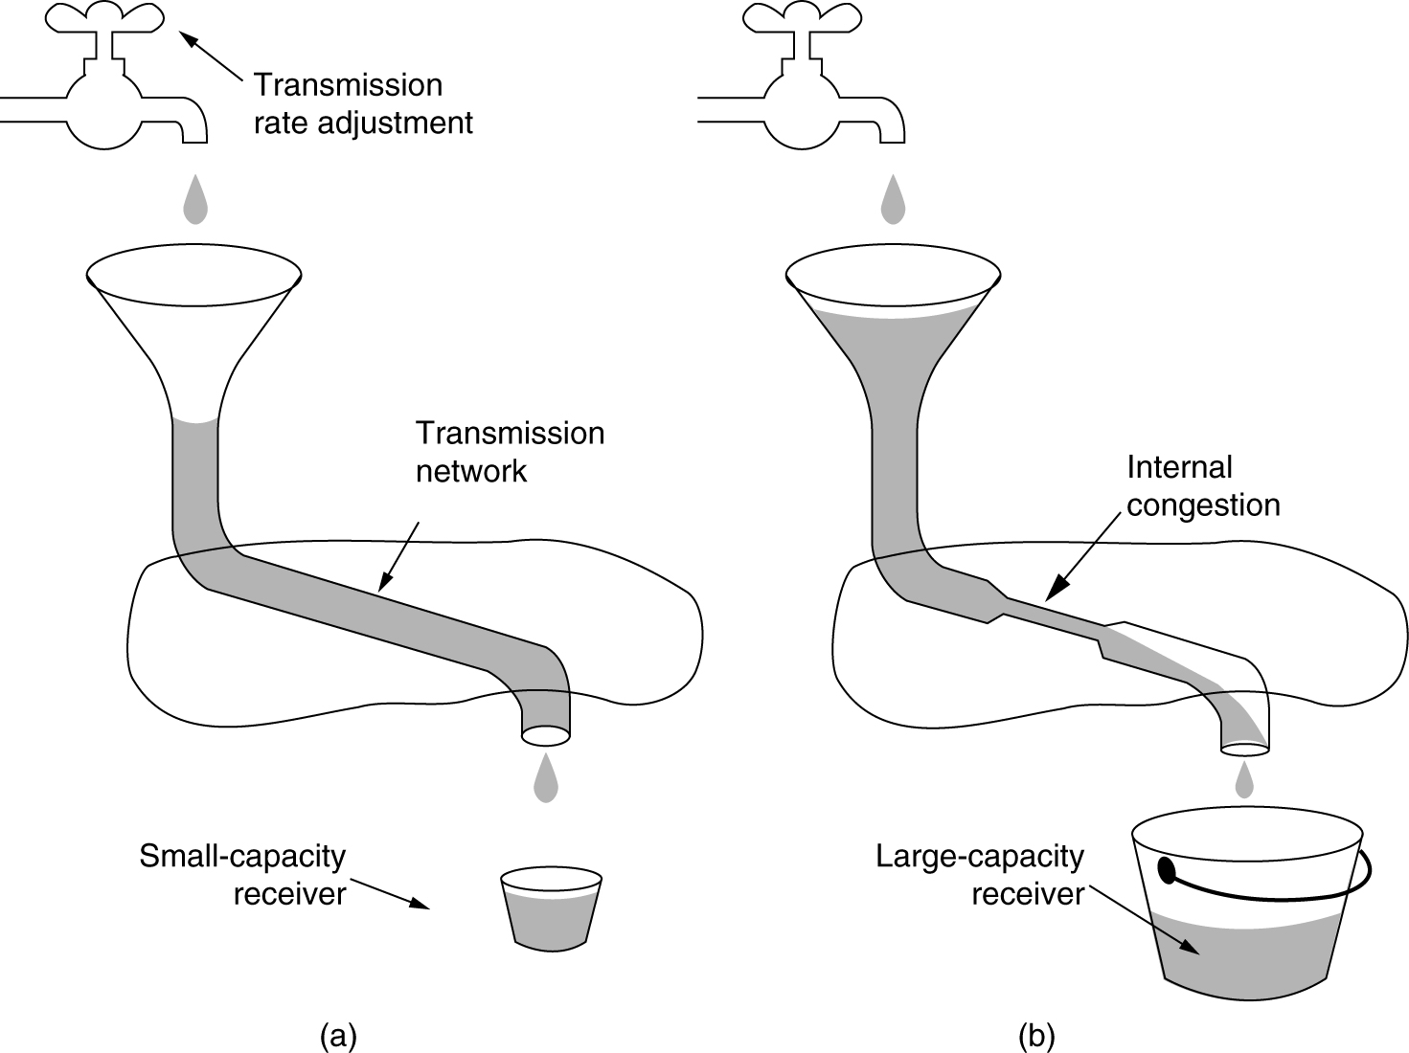
TCP Congestion Control
(a) A fast network feeding a low capacity receiver.
(b) A slow network feeding a high-capacity receiver.

Slide 44
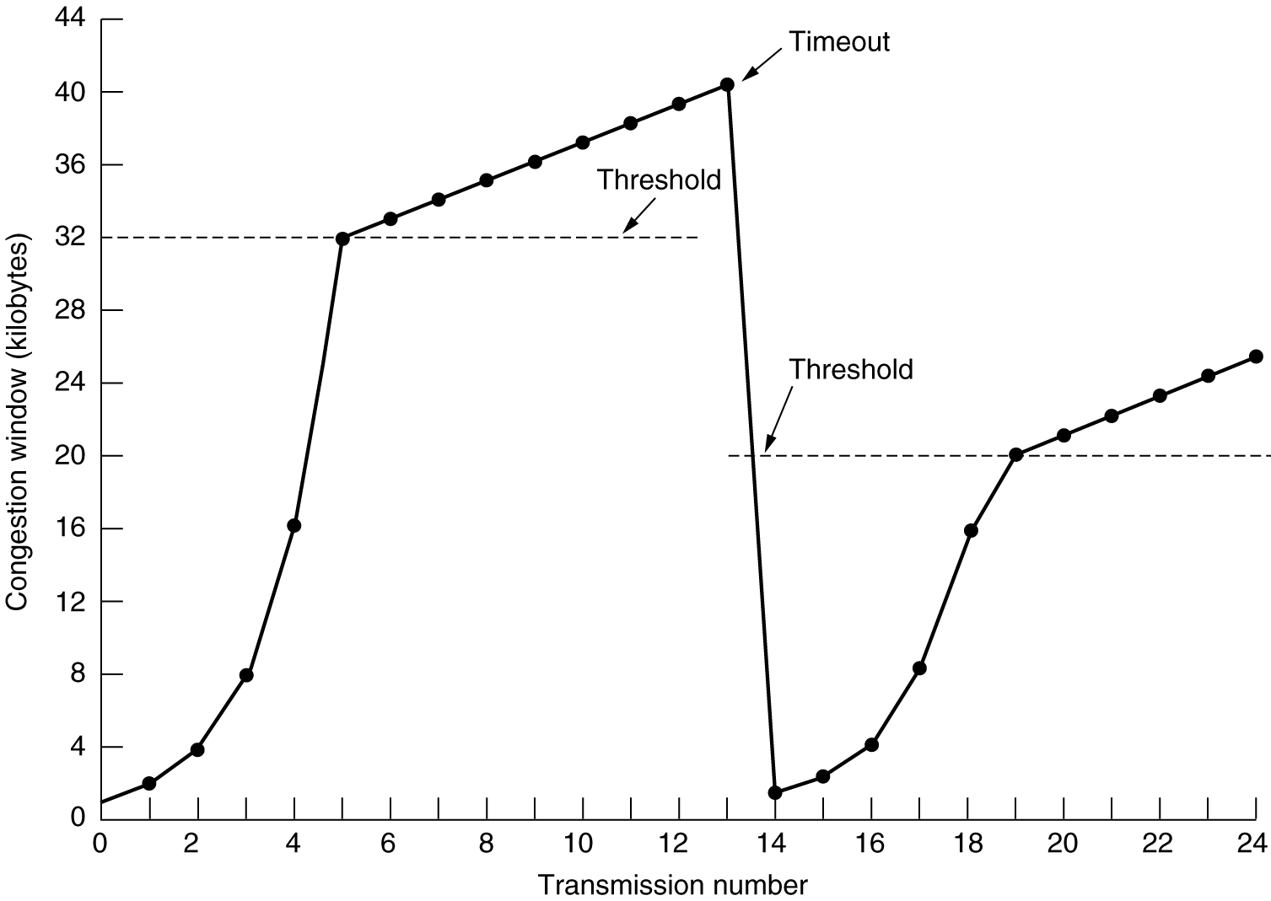
TCP Congestion Control (2)
An example of the Internet congestion algorithm.

Slide 45
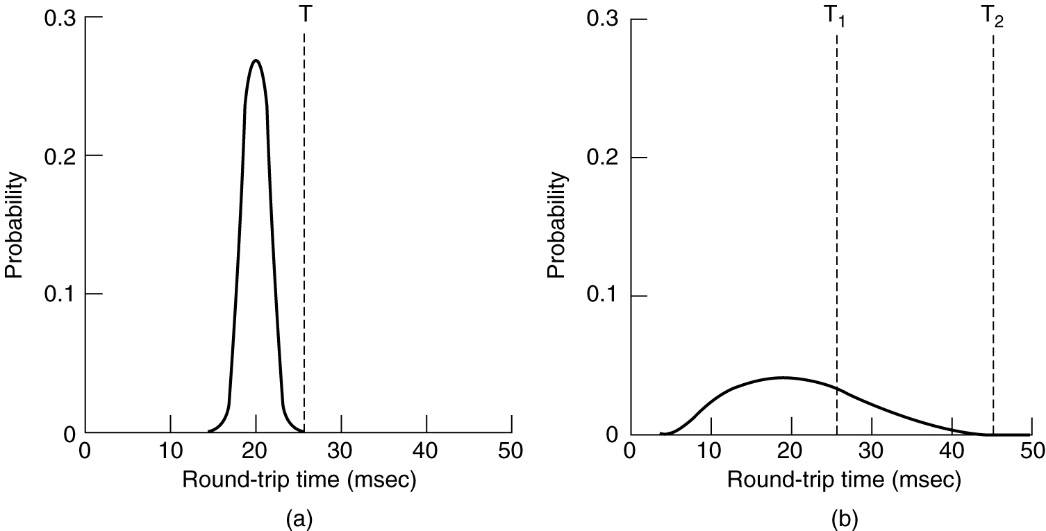
TCP Timer Management
(a) Probability density of ACK arrival times in the data link layer.
(b) Probability density of ACK arrival times for TCP.

